Slide 1
Toronto Restaurant Market Opportunity Analysis

Slide 2
Business problem and Background
A restaurant business is interested in opening a new restaurant in Toronto. Which kind of restaurant and where to open the restaurant are very important factors for the business’s success.
I use the neighborhood listings and the FourSquare venue listings from prior projects to obtain a picture of which and how many restaurants of different types can be found in the different neighborhoods of Toronto.
We then compare the frequencies of different types of restaurants across neighborhoods to find out where there may be fewer restaurants than the market can support, which we can recommend as opportunities to open new restaurants of different types.

Slide 3
Data Acquisition and Preprocessing
Toronto neighborhood data and geospatial data (latitude and longitude) can be found in the website https://en.wikipedia.org/wiki/List_of_postal_codes_of_Canada:_M and http://cocl.us/Geospatial_data . Venue listings are queried from FourSquare API.

Slide 4
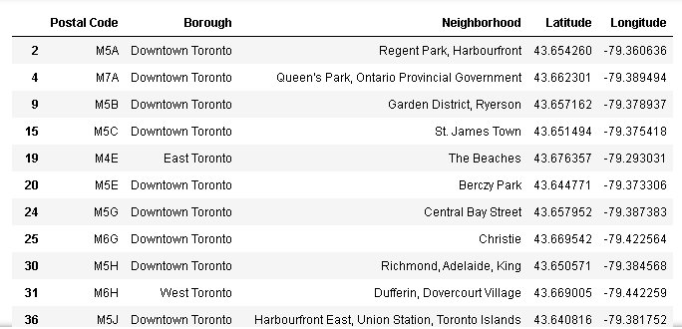
Data Acquisition and Preprocessing
Data from webpage was scraped and read into Panda data frame and merged.

Slide 5
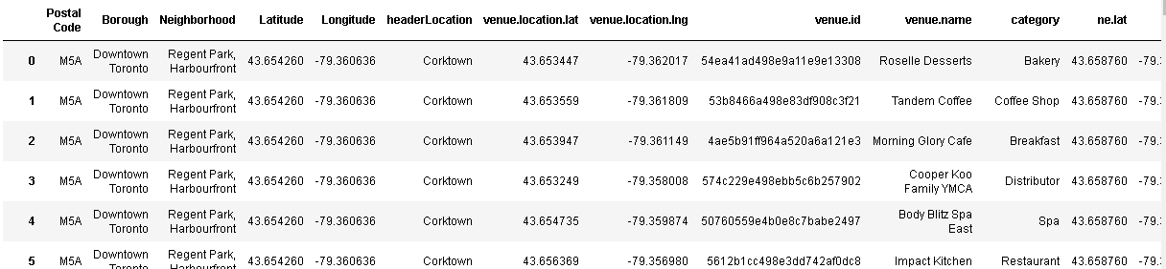
Data Acquisition and Preprocessing
Examples of Toronto neighborhood Venue Listing

Slide 6
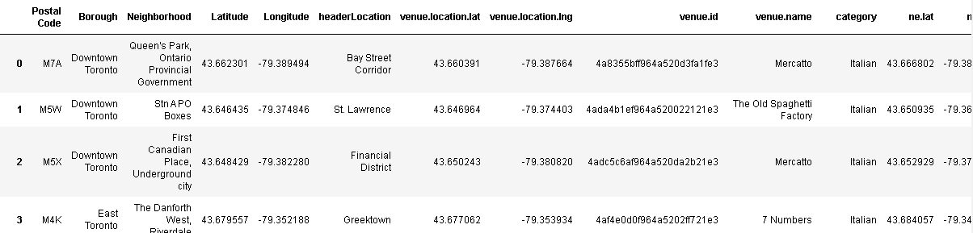
Data Acquisition and Preprocessing
After each venue was assigned to the closest postal code neighborhood and non restaurant venues and any types with 5 or less venues dropped, the data is ready for analysis.

Slide 7
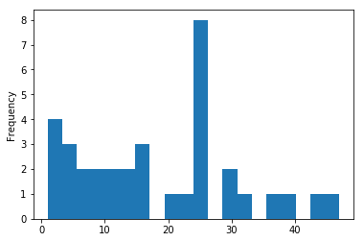
Exploratory Data Analysis
Toronto Neighborhood Restaurant Distribution

Slide 8
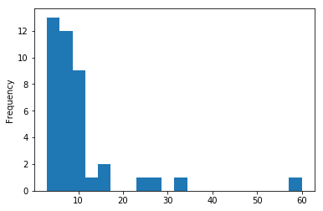
Exploratory Data Analysis
Restaurant Distribution in Popular Neighborhoods

Slide 9
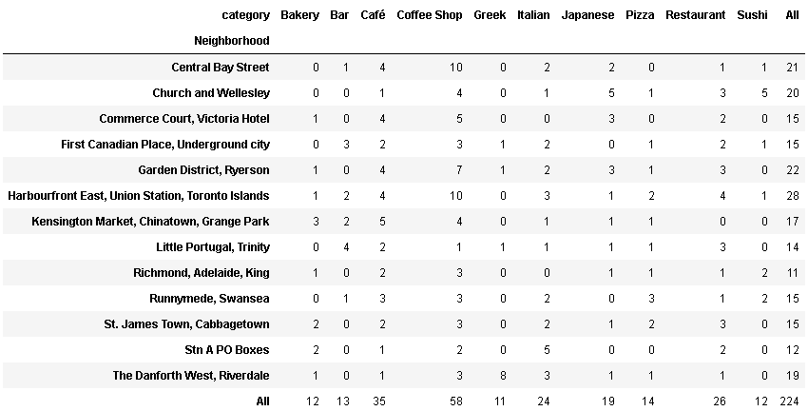
Exploratory Data Analysis
Neighborhood with 10 or more restaurant

Slide 10
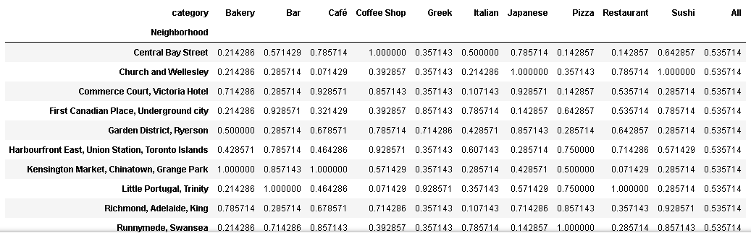
Exploratory Data Analysis
Normalizing and Ranking Each Cuisine in Defferent Neighborhood

Slide 11
Recommendentions
Neighborhood | category | value
Central Bay Street | Pizza | 0.153846
Central Bay Street | Restaurant | 0.153846
Church and Wellesley | Café | 0.076923
Church and Wellesley | Italian | 0.153846
Commerce Court, Victoria Hotel | Italian | 0.076923
Commerce Court, Victoria Hotel | Pizza | 0.153846
Kensington Market, Chinatown, Grange Park | Restaurant | 0.076923
Little Portugal, Trinity | Coffee Shop | 0.076923
Runnymede, Swansea | Japanese | 0.115385
Stn A PO Boxes | Japanese | 0.115385
Stn A PO Boxes | Pizza | 0.153846
The Danforth West, Riverdale | Café | 0.153846
The Danforth West, Riverdale | Coffee Shop | 0.153846

Slide 12
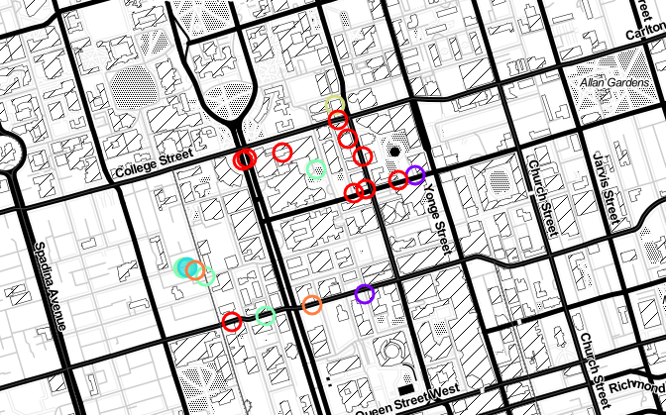
Recommendations
Central Bay Street Recommendations: pizza, Restaurant
Empty dots: not competitor
Filled dots: competitor

Slide 13
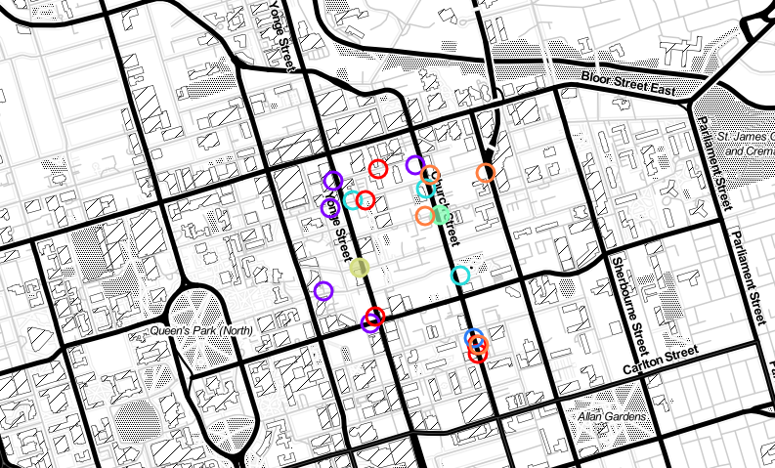
Recommendations
Church and Wellesley Recommendations: Café, Italian
Empty dots: not competitor
Filled dots: competitor

Slide 14
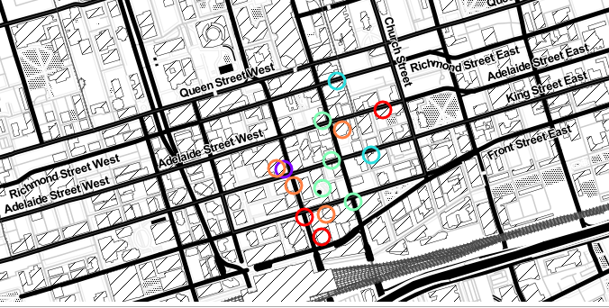
Recommendations
Commerce Court, Victoria Hotel Recommendations: Italian, Pizza
Empty dots: not competitor
Filled dots: competitor

Slide 15
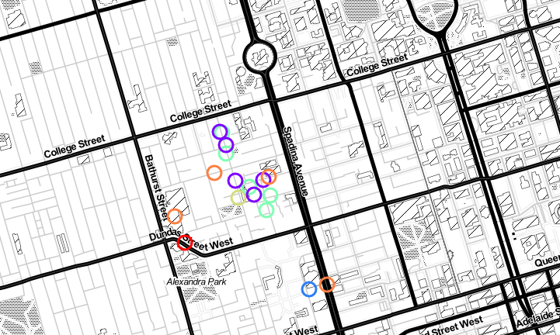
Recommendations
Kensington Market, Chinatown, Grange Park Recommendations: Restaurant
Empty dots: not competitor
Filled dots: competitor

Slide 16
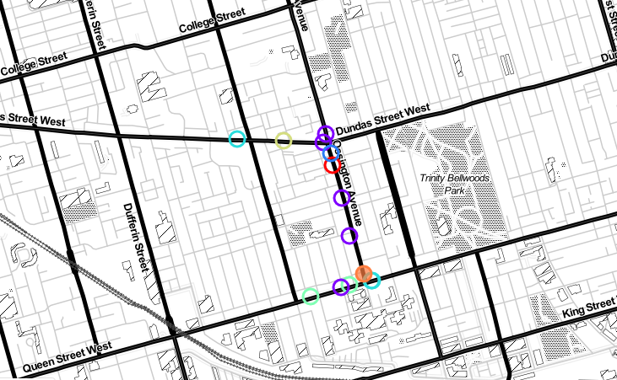
Recommendations
Little Portugal, Trinity Recommendations: Coffee Shop
Empty dots: not competitor
Filled dots: competitor

Slide 17
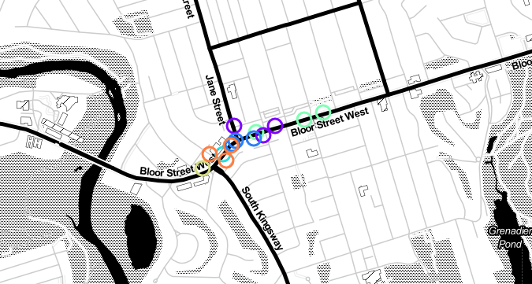
Recommendations
Runnymede, Swansea Recommendations: Japanese
Empty dots: not competitor
Filled dots: competitor

Slide 18
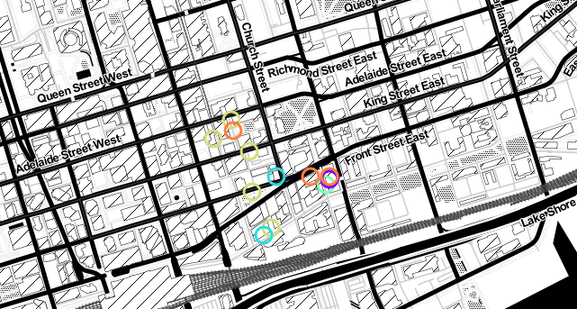
Recommendations
Stn A PO Boxes Recommendations: Japanese, Pizza
Empty dots: not competitor
Filled dots: competitor

Slide 19
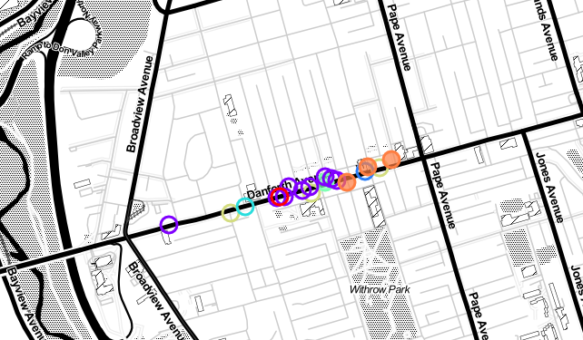
Recommendations
The DanDanforth West, Riverdale Recommendations: Café, Coffee Shop
Empty dots: not competitor
Filled dots: competitor

Slide 20
Discussion
I made this recommendation sole based on the existing restaurant on the market. I chose the neighborhood in the bottom 20% of that cuisine. This kind of cuisine could be less competitive.
One can argue that this cuisine could also be less popular in that neighborhood.
If I had data about the demographics of each neighborhood and survey data about people’s taste, I could include that information into my recommendations. Then I will have the full picture of the restaurant market and my recommendation will be more accurate.

